Slide 1
Fraud Detection in Financial Transactions
Team Members:
Beshoy Baha
George Akram
Abd El Rahman Khaled
Ayman Essam

Slide 2
Agenda
Fraud detection
Data Source
Pipeline
Data Explore
Data Preprocessing
Machine Learning Models
Using NLP to analysis transaction descriptions or notes.
Using Gans to Generate Data to fix the Imbalanced Data
Implement The model Using Microsoft Azure
MLflow to manage and track fraud detection models.

Slide 3
Introduction
Fraud detection in financial transactions is crucial to safeguard against identity theft, credit card fraud, and money laundering. Modern systems leverage AI, machine learning, and data analytics to detect suspicious activity in real time. These technologies enhance accuracy, reduce false positives, and help combat evolving fraud tactics, ensuring financial security.

Slide 4
Data Source

Slide 5
Due to the private nature of financial data, there is a lack of publicly available datasets that can be used for analysis. In this project, a synthetic dataset, publicly available on Kaggle, generated using a simulator called PaySim is used.

Slide 6
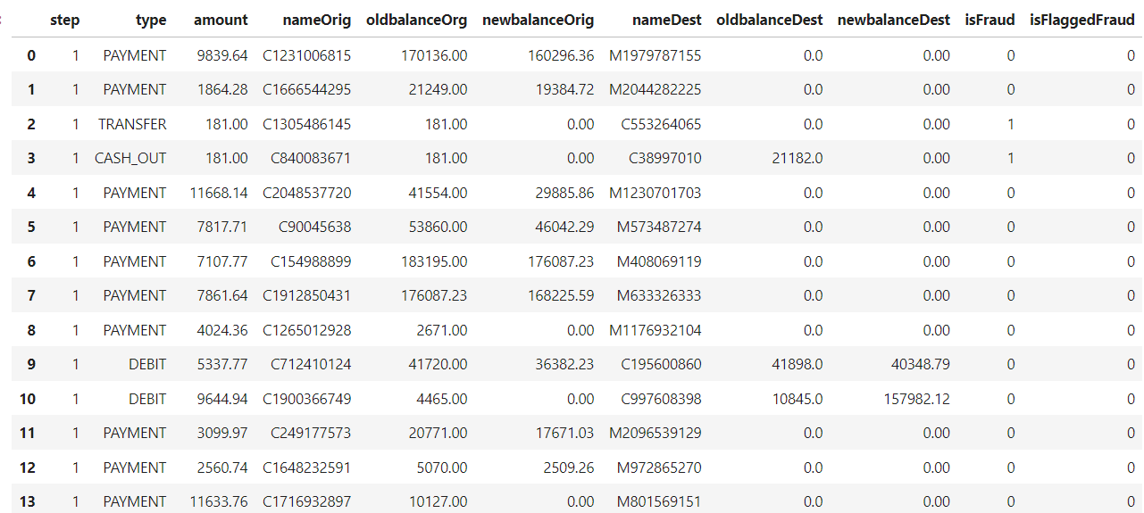
PaySim dataset
Shape : 6362620 rows × 11 columns

Slide 7
Pipeline

Slide 8
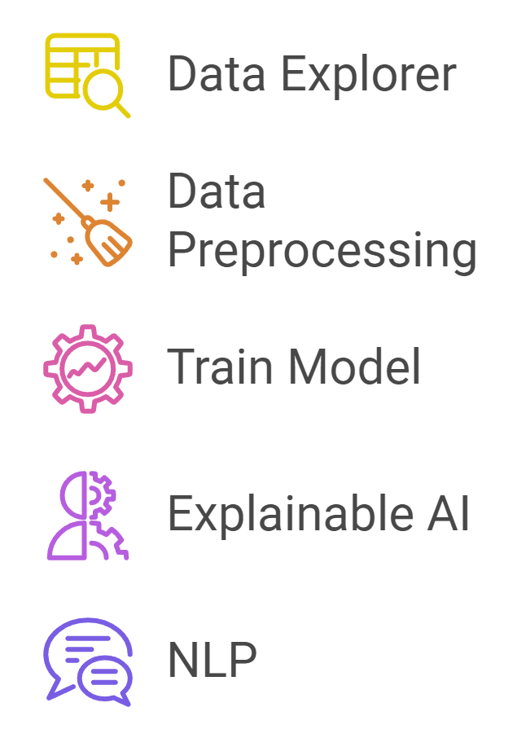

Slide 9
Data Explore

Slide 10
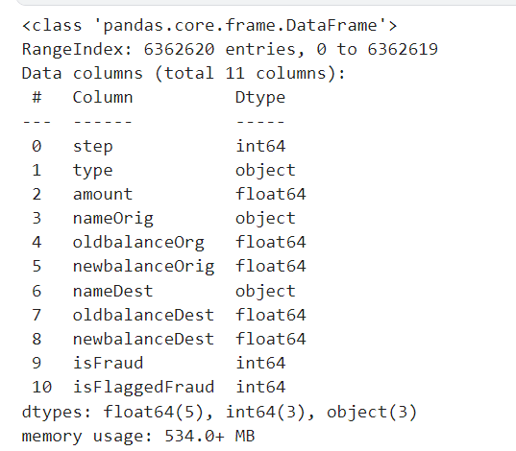
Data Info
The Data contains 11 Futures :

Slide 11
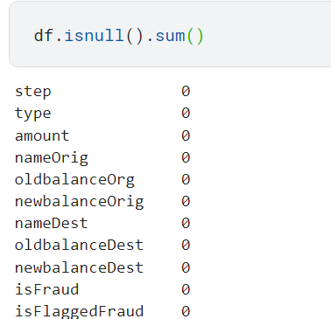
Checking for Null Values And Duplicate
Check The Null Values
Check The Duplicate

Slide 12
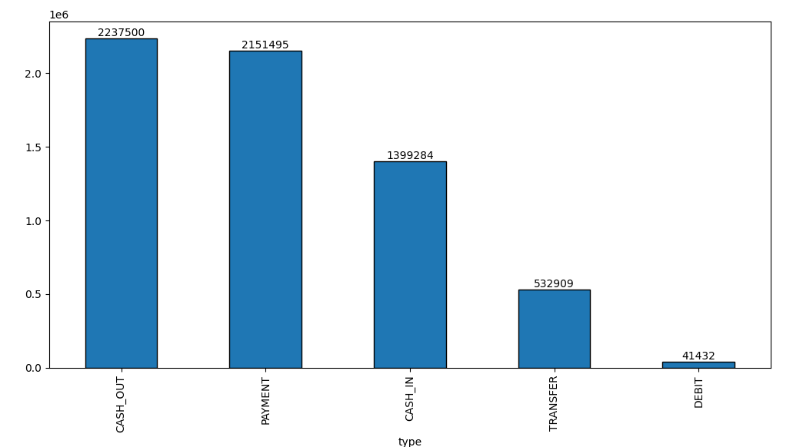
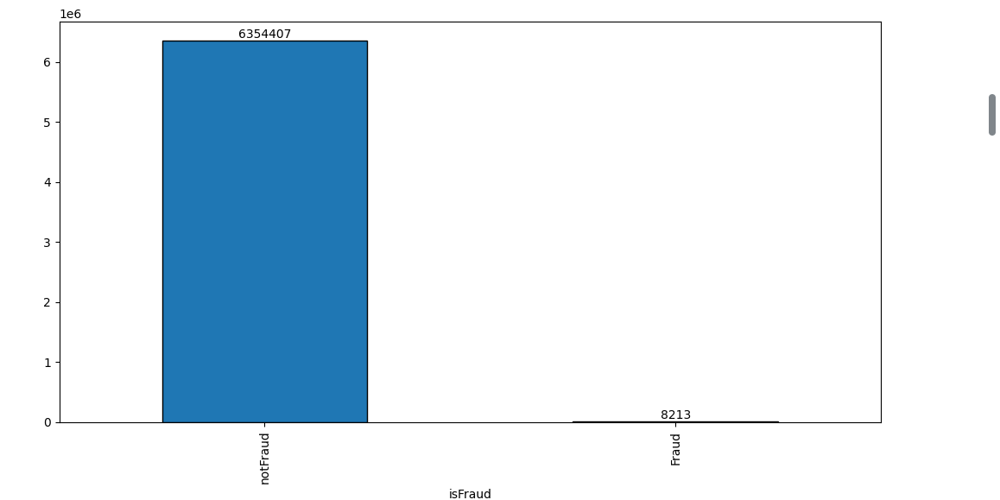
Draw A Histogram For the Type and the fraud Features
Histogram For the Type
Histogram For the fraud

Slide 13
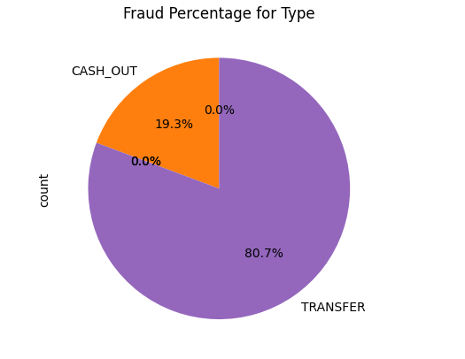
Fraud transactions by type

Slide 14
Data Preprocessing

Slide 15
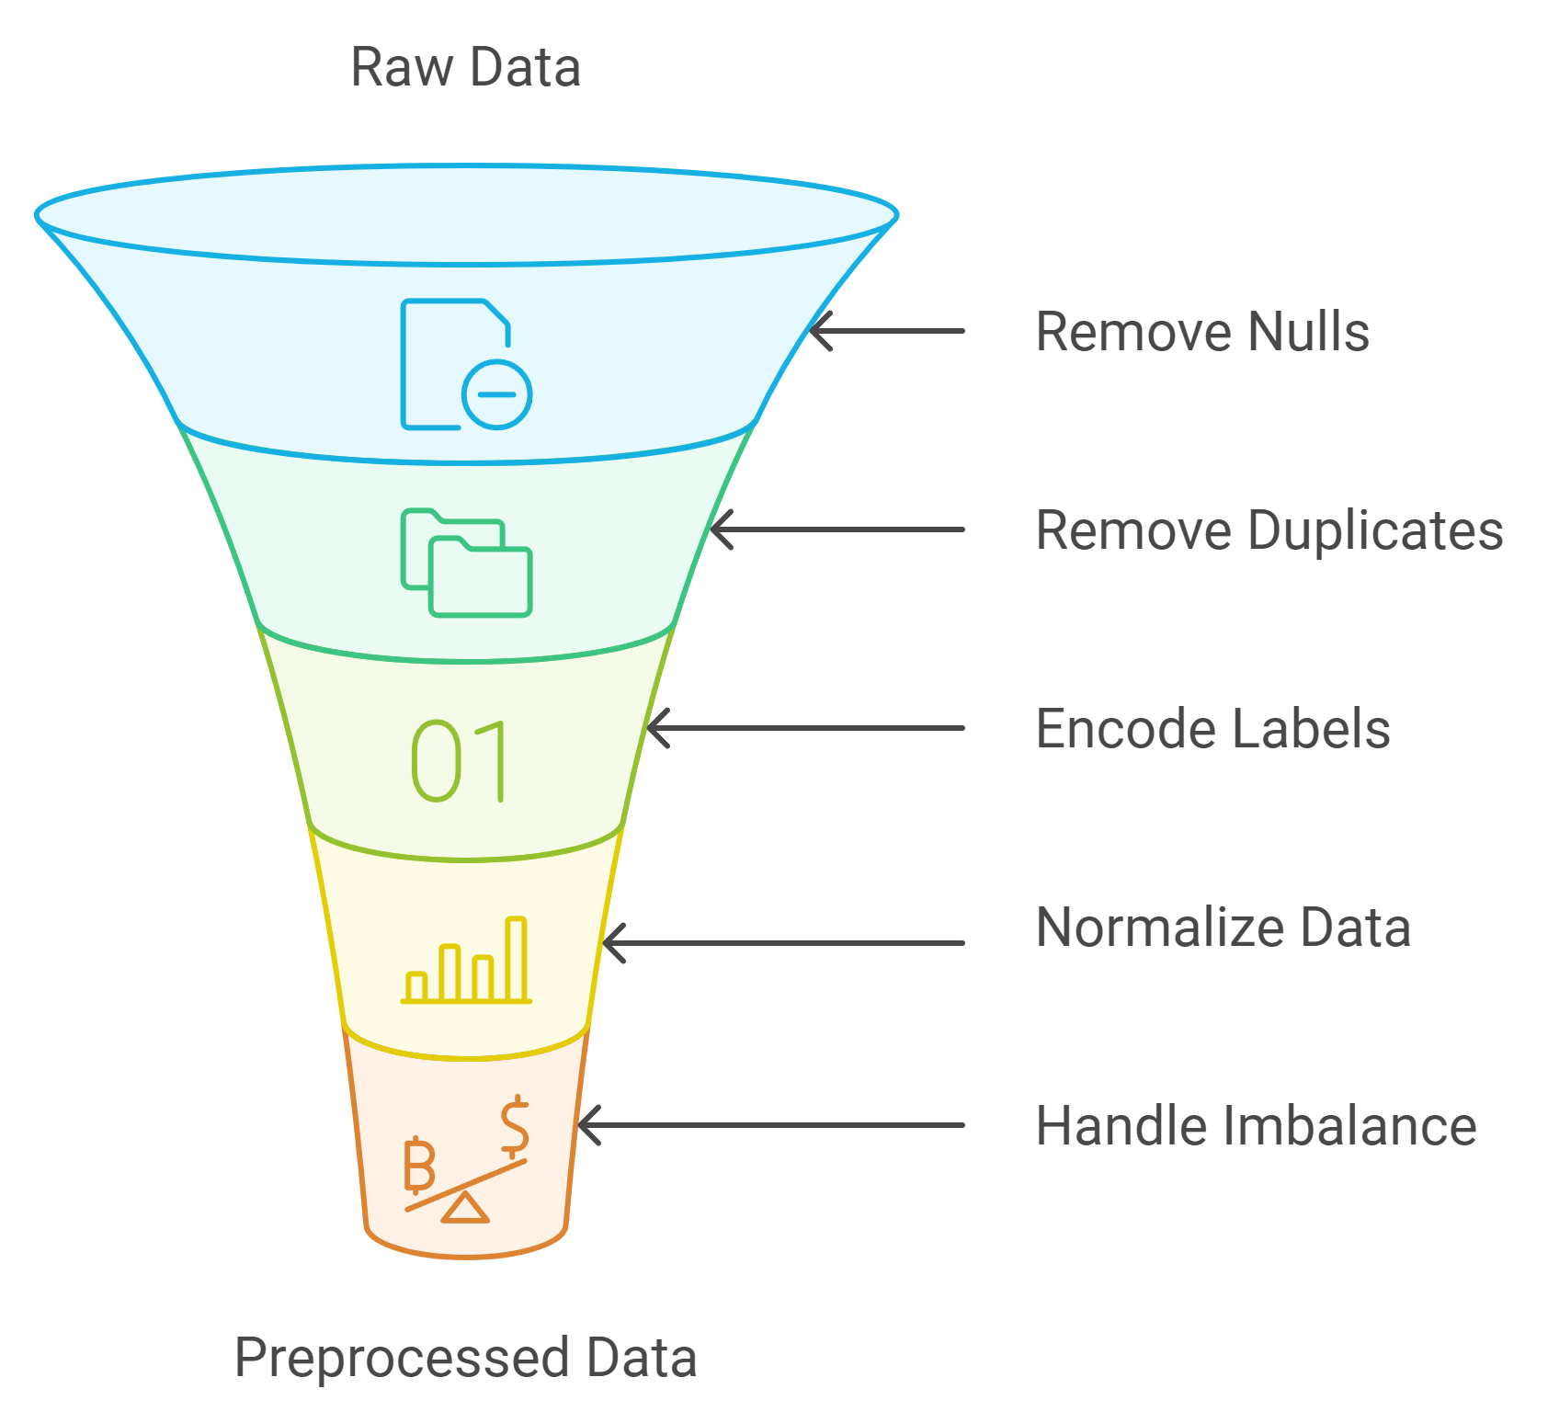

Slide 16
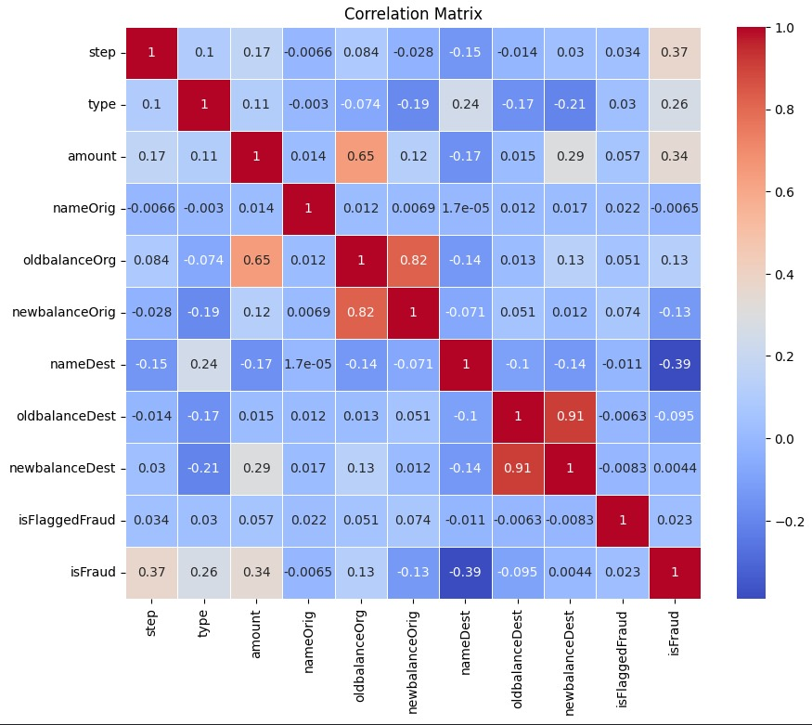

Slide 17
SMOTE VS GANs

Slide 18
WGANs
 | Step | Type | amount | oldbalanceOrg | newbalanceOrig | oldbalanceDest | newbalanceDest
1 | 1.0 | 0.0 | 176384.875000 | 212895.046875 | -37065.992188 | -7.691043e+04 | -1.651141e+04
2 | 1.0 | 0.0 | 176172.484375 | 213093.046875 | -37808.539062 | -8.454568e+04 | -2.681579e+04
3 | 1.0 | 0.0 | 127915.726562 | 215861.843750 | -119374.820312 | -1.409287e+06 | -1.452619e+06
4 | 1.0 | 0.0 | 176316.625000 | 213009.250000 | -37419.871094 | -7.989955e+04 | -2.127985e+04
Duplication = 13.365%

Slide 19
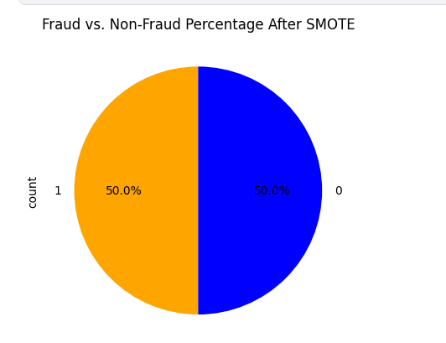
SMOTE

Slide 20
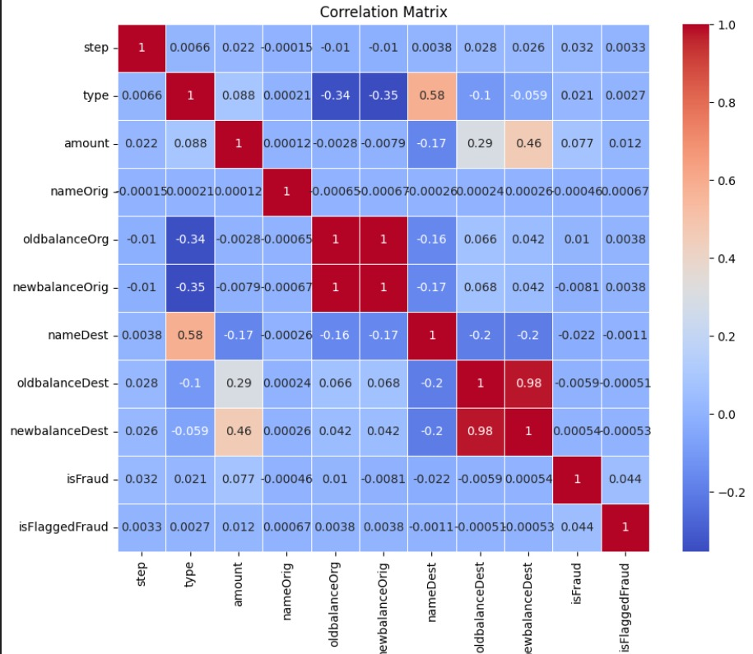

Slide 21
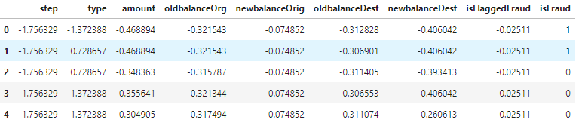
Standard Scaler
Shape : 12708814 rows × 11 columns

Slide 22
Machine Learning Models and MLFlow

Slide 23
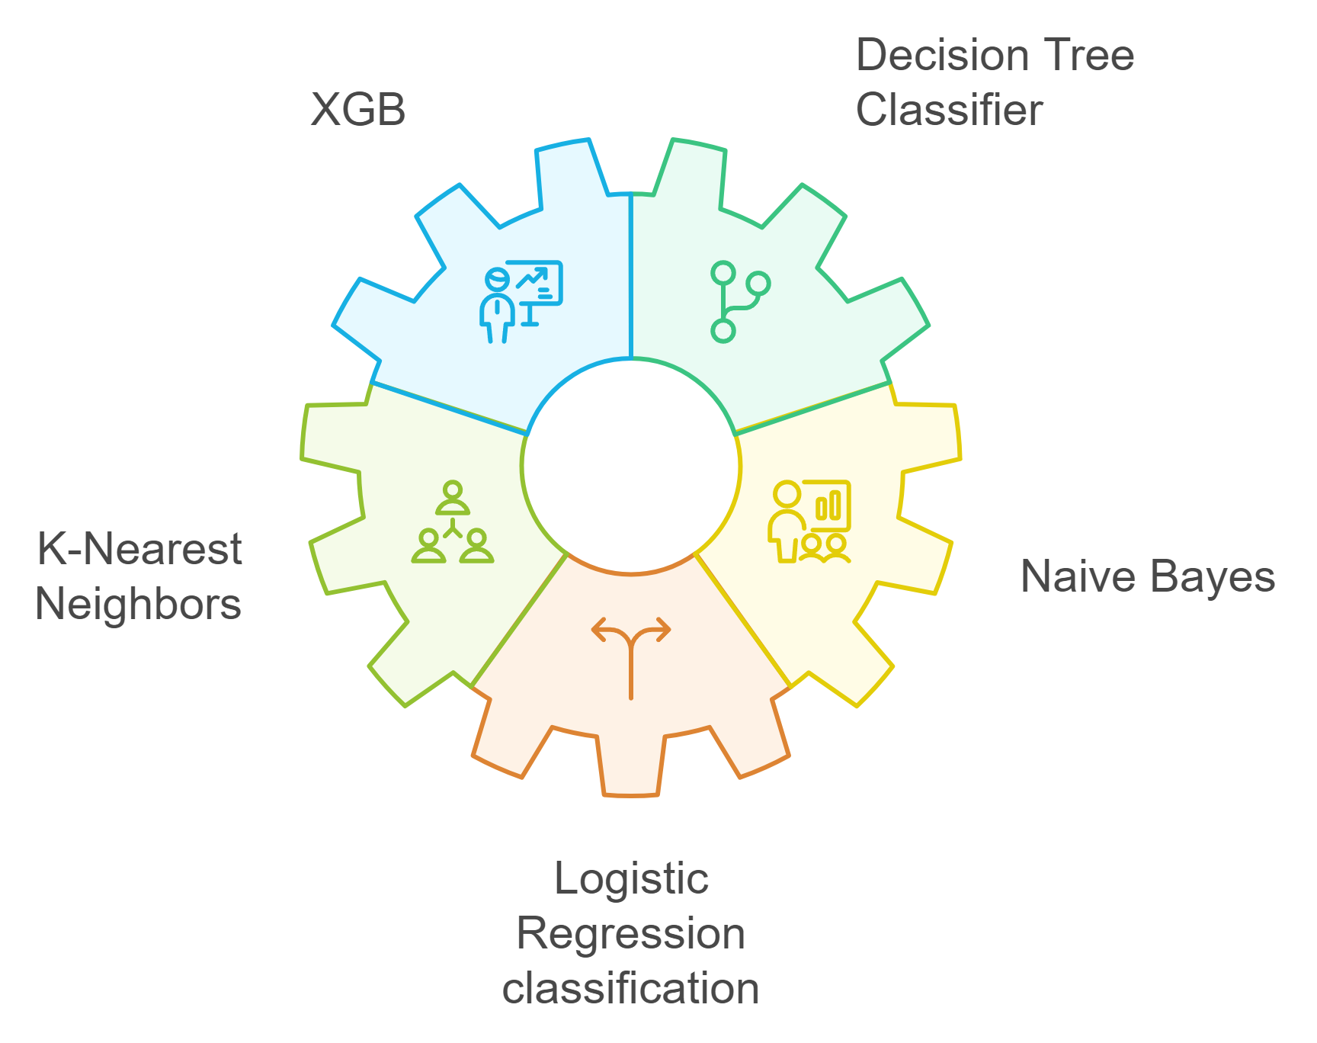

Slide 24
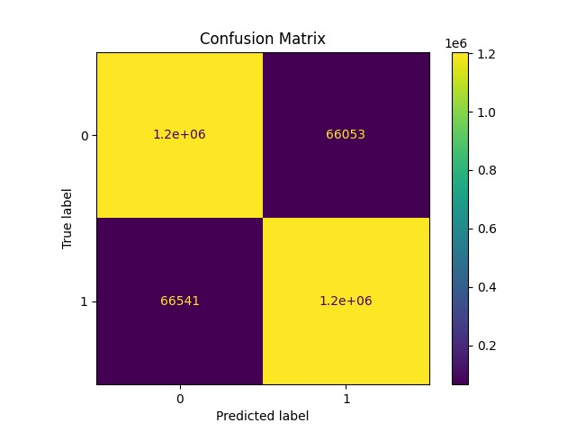
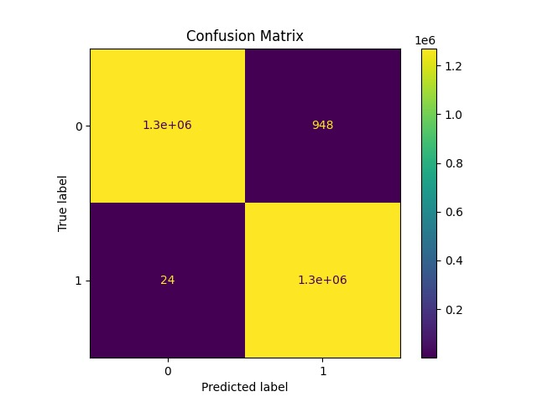
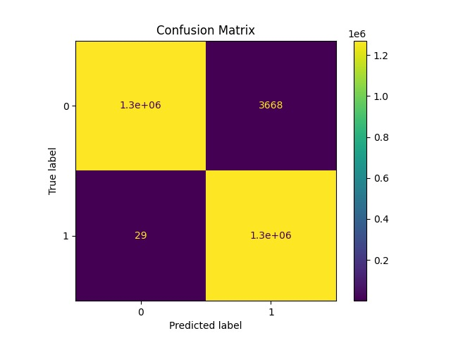
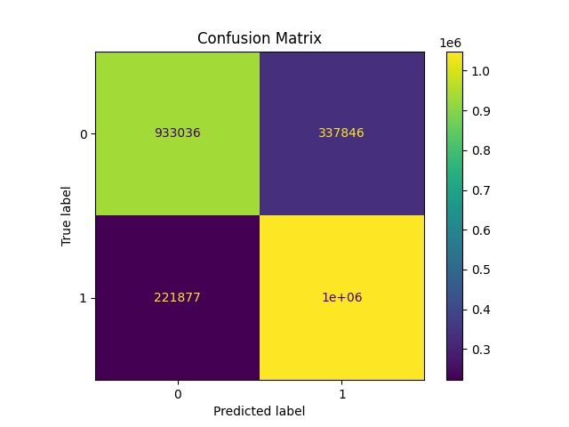

MLFlow artifacts
Logistic regression classification
XGB
k nearest neighbor
naive bayes
decision tree

Slide 25
Logistic regression classification
accuracy :
F1 score :
Precision :
Recall :
0.9478338460352126
0.9478238080584778
0.9480058533068113
0.9476418327128976

Slide 26
Naive Bayes
accuracy :
F1 score :
Precision :
Recall :
0.7797894610945237
0.7893981746083407
0.7563932653134802
0.825414810670708

Slide 27
k nearest neighbor
accuracy :
F1 score :
Precision :
Recall :
0.9985454977509705
0.9985475765900933
0.9971220537928004
0.9999771811837616

Slide 28
Decision Tree Classifier
accuracy :
F1 score :
Precision :
Recall :
0.9994551026197172
0.9994552290732247
0.9992229478903193
0.9996876182742522

Slide 29
XGB
accuracy :
F1 score :
Precision :
Recall :
0.9996175882645235
0.9996177270807327
0.9992546027103212
0.9999811154624233

Slide 30
Compare
 | accuracy | F1 score | Precision | Recall
Naive Bayes | 0.7797894610945237 | 0.7893981746083407 | 0.7563932653134802 | 0.825414810670708
Logistic regression classification | 0.9478338460352126 | 0.9478238080584778 | 0.9480058533068113 | 0.9476418327128976
k nearest neighbor | 0.9985454977509705 | 0.9985475765900933 | 0.9971220537928004 | 0.9999771811837616
Decision Tree Classifier | 0.9994551026197172 | 0.9994552290732247 | 0.9992229478903193 | 0.9996876182742522
XGB | 0.9996175882645235 | 0.9996177270807327 | 0.9992546027103212 | 0.9999811154624233

Slide 31
Implement The model Using Microsoft Azure

Slide 32
Pipeline Designer
Load data
Split Data
Train the model
(Decision forest)
Drop columns
Normalization
Evaluation
Label Encoder
SMOTE

Slide 33
Output samples
Json File
"step": 1, "type": "CASH_OUT", "amount": 2806, "oldbalanceOrg": 2806, "newbalanceOrig": 0, "oldbalanceDest": 26202, "newbalanceDest": 0
Json File
Endpoint
"Scored Labels": 1.0
"Scored Probabilities": 0.9921079429735234
(Fraud)

Slide 34
Output samples
Json File
"step": 1, "type": "PAYMENT", "amount": 4024.36, "oldbalanceOrg": 2671, "newbalanceOrig": 0, "oldbalanceDest": 0, "newbalanceDest": 0
Json File
Endpoint
"Scored Labels": 0.0
"Scored Probabilities": 0.0
(not fraud)

Slide 35
Who knows what is that reasons for being fraud

Slide 36

SHAP

Slide 37
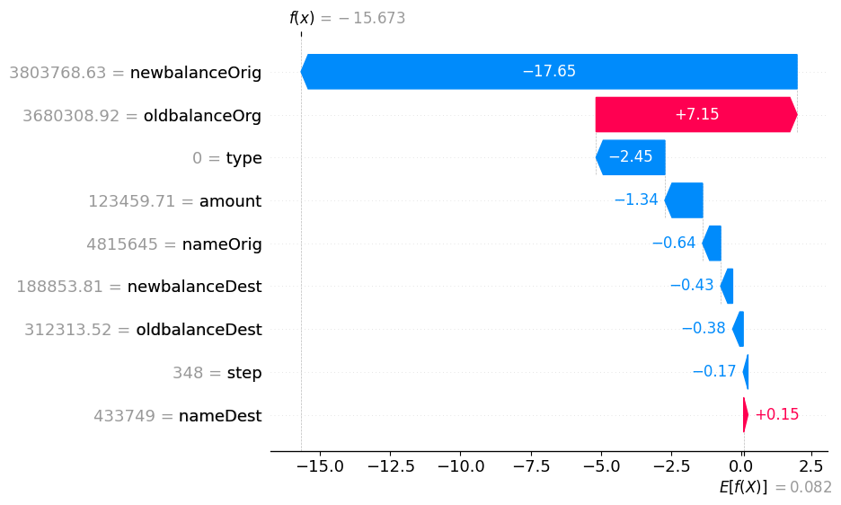

Slide 38
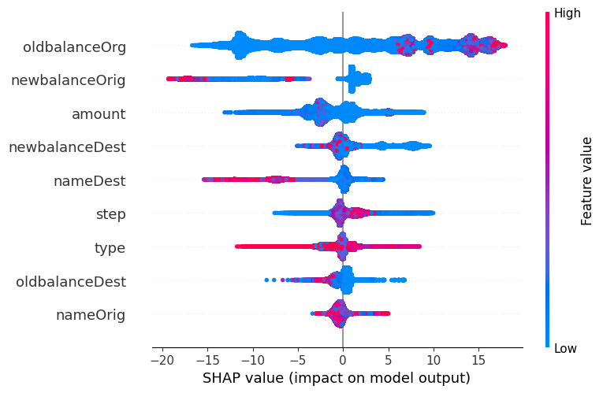

Slide 39
Mapping features
step = Anomalous Timing of Transactions
type = High-Risk Transaction Type
amount = Unusual Transaction Amount
nameOrig = Suspicious Originating Account
oldbalanceOrg = Dramatic Balance Decrease
newbalanceOrig = Dangerously Low Balance Post-Transaction
nameDest = Transactions to Unverified Accounts
oldbalanceDest = Low Initial Balance in Destination Account
newbalanceDest = Significant Increase in Destination Balance

Slide 40
NLP

Slide 41


Slide 42
{top 3 reasons}
take those tags and make email that is from a bank that tell the customer {name} that his transaction is a fraud based on those tags

Slide 43
Subject: Urgent Action Required: Suspicious Transaction on Your Account
Dear John Doe,
We are writing to inform you of a suspicious transaction on your account that requires immediate attention. Our fraud detection system has flagged a recent transaction that triggered several security alerts, indicating potential fraudulent activity.
The following concerning factors were detected:
Dangerously Low Balance Post-Transaction: The transaction resulted in a significantly low balance on your account.
Dramatic Balance Decrease: There was a sudden and substantial decrease in your account balance following the transaction.
Significant Increase in Destination Balance: The recipient of the transaction experienced a significant increase in their account balance.
We are taking this matter very seriously and are committed to protecting your financial well-being. To ensure your account security, we have temporarily frozen your account.
To resolve this situation, please take the following steps immediately:
1. Contact us at [phone number] or [email address] to verify your identity and confirm whether you authorized this transaction.
2. If you did not authorize this transaction, please report it to us immediately.
3. We will investigate the matter thoroughly and take appropriate action to restore your account security.
We understand this may be concerning, and we appreciate your cooperation in addressing this issue. We are here to assist you in any way we can.
Sincerely,
The [Bank Name] Security Team

Slide 44
Thank you for your time

